Slide 1
Missouri 911 Service Board NG911 GIS Consulting Services Project Final Report Recommendations
January 18, 2022
Prepared by: Jessica Frye, GIS Project

Slide 2
Project Goals
Assist MO 911 SB in establishing the Missouri NG9 1 1 GIS Standard and Best Practices Document based on the National Emergency Number Association (NENA) NG9 1 1 Data Model;
Develop and host virtual and one recorded educational session based on the Missouri NG9 1 1 GIS Standard and Best Practices;
Perform an assessment of each local jurisdiction’s 9-1-1 GIS data to determine the level of current compliance with the Missouri NG9-1-1 GIS Standard; and
Prepare a final report to include the details of the project.
Notes:
Cheryl

Slide 3
Current Statewide GIS Accuracy Estimate
83.12% | All identified errors (non-critical and critical)
Including errors for all 9-1-1 GIS data layers
86.98% | Identified critical errors
Only errors identified in the layers required for NG9-1-1 call routing

Slide 4
Critical Next Steps and Recommendations
Continual Coordination between 9‑1‑1 and GIS Personnel
NG9-1-1 GIS Legislation, Governance and Procedures
Procure NG9‑1‑1 GIS Data Management Services
Standardization of Non-Standard USPS Post Types & Street Names in the Legacy Databases
Implementation of a GIS Derived MSAG

Slide 5
Resources Received
Resources | Counties Submitting | Counties NOT Submitting
Provisioning Boundary | 87 | 8
PSAP Boundary | 87 | 8
Emergency Service Boundaries – EMS | 83 | 12
Emergency Service Boundaries – Fire | 90 | 5
Emergency Service Boundaries – Law | 79 | 16
Road Centerlines | 95 | 0
Site Structure Address Points | 92 | 3
Incorporated Municipalities* | 81 | 14
County* | 89 | 6
ALI | 75 | 20
MSAG | 80 | 15
*Layer strongly recommended; not required

Slide 6
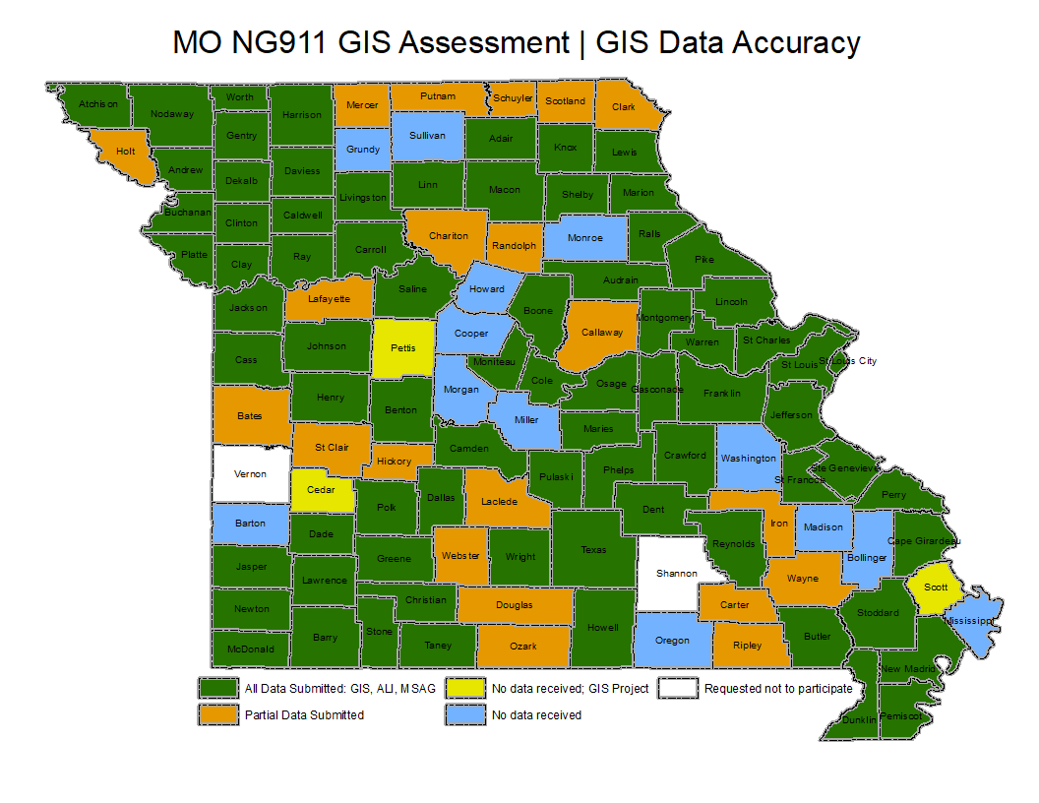
Resources Received

Slide 7
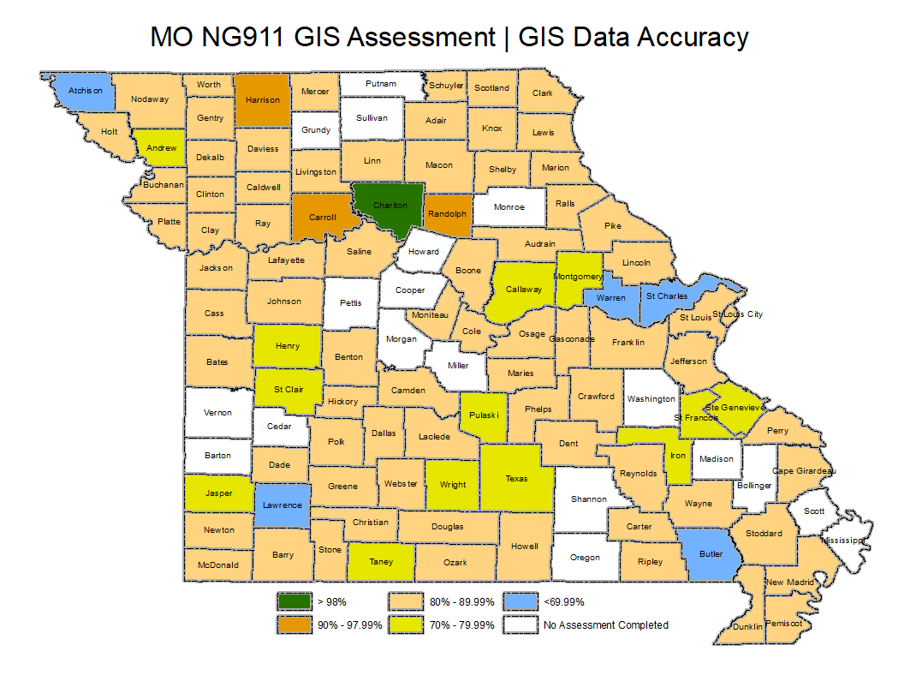
Current Local GIS Data Accuracy

Slide 8
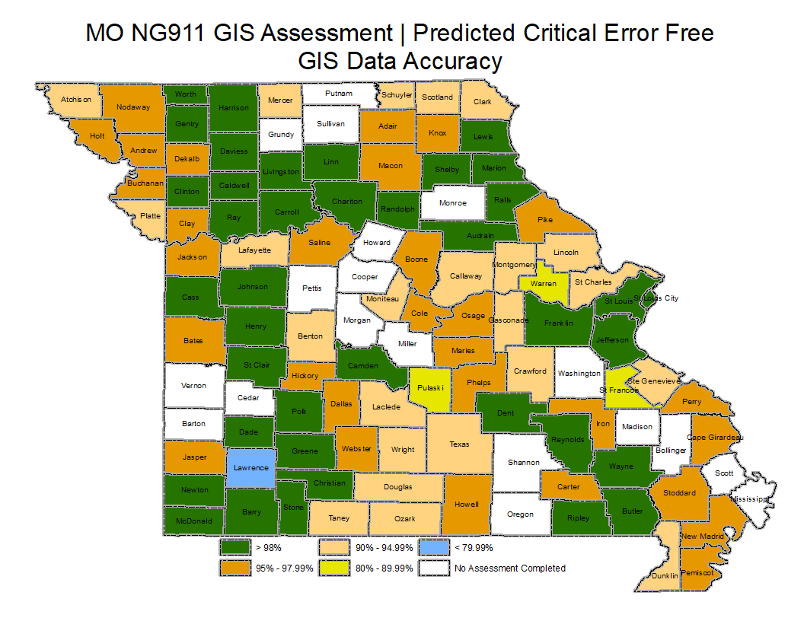
Predicted Local GIS Data Accuracy | All critical errors resolved
IMPORTANT: Accuracy as a
percentage of GIS data is not a
typical benchmark for transition
to NG9-1-1. Being critical
error free is required.

Slide 9
ALI and MSAG Synchronization
Resources | Current Accuracy
ALI to Road Centerline | 75.19%
ALI to Site/Structure Address Points | 67.63%
MSAG to Road Centerline | 57.18%
*i3 transition typically requires each PSAP achieve a 98% ALI to Road Centerline synchronization rate.

Slide 10
Questions + Discussion
contact:
Jessica Frye jfrye@geo-comm.com
(320) 281-2554 geocomm.com

