Slide 1
NG911 GIS Data Remediation Grant Process
Shawn Penman, PhD, GISP, CFM GIS Consultant Missouri 911 Service Board
Brian Maydwell, ENP
Executive Director Missouri 911 Service Board

Slide 2
Is your GIS data NG911 Ready?
Yes
Submit data to Missouri Aggregation & Validation Portal
Apply to Board for GIS Data Remediation Grant
No

Slide 3
GIS Grant
Do you have GIS Data?
What data do you have?
Request Project Assessment Quotation (PAQ) from Approved Vendors
Requirements
GIS Data must meet Missouri NG911 GIS Standard
Evaluate & Score Vendor Responses
Completeness
Cost
Road Centerlines
Address Points
Provisioning Boundary
Emergency Service Boundaries
Incorporated Municipality Boundaries
County Boundaries
Required layers listed in Standard
Quality
Schedule
Fill out GIS Grant Application
Send Board copy of PAQ for completeness review
No funding for parcels or PII data
Fill out PSAP Survey if not completed
90/10 Match Requirement

Slide 4
PAQ REQUEST PROCESS
Step 1
Step3
Step 5
Local Entity Issues PAQ
Vendor Responds
Local Entity Evaluates
Award Notification
Project Starts
Step 2
Step 4

Slide 5
Vendor Selected
Contract
Specifications
Data Creation or Remediation
Missouri Standards
NENA Standards
Data Validation
Upload to Portal
Validation against Missouri Standard
Board Approval
Payments
Invoice submitted to Board
Board submits to Missouri ARPA Portal

Slide 6
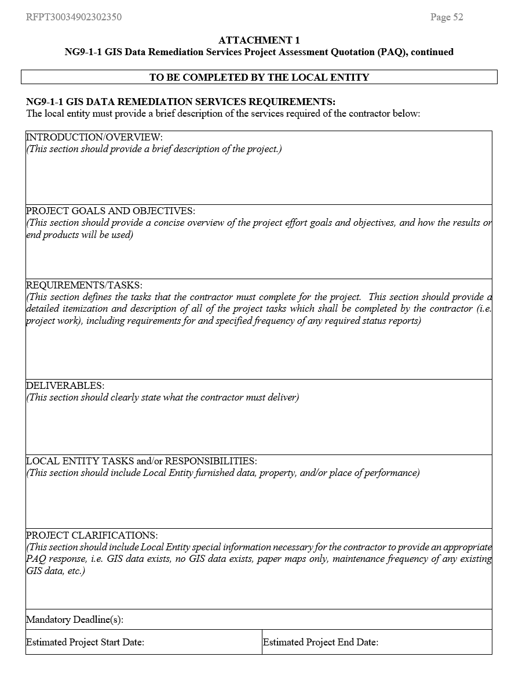
NG911 GIS Data Remediation Services Requirements
Project Introduction
Project Goals and Objectives
Requirements/Tasks
Deliverable
Local Entity Task and/or Responsibilities
Project Clarifications

Slide 7
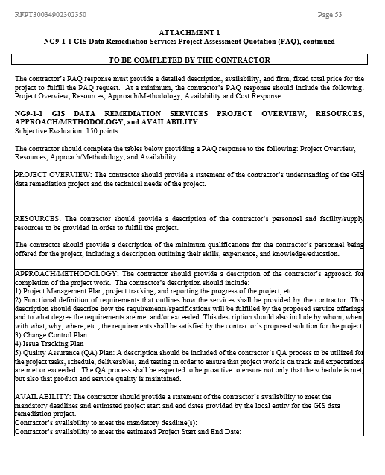
Contractor Response
Project Overview
Resources
Approach/Methodology
Availability
Cost

Slide 8
What Makes a PAQ Response Great?
Clear & Concise
Solve Problems
Project Portfolio
Detailed Plan
State Resources
Skilled Team
Project Roles
Current Resumes
Valid Schedule
Cost
Quality vs. Quantity
Why You?

Slide 9
Approval and Award of PAQ
For each PAQ response, the local entity shall total:
The cost points derived from the cost analysis,
The subjective evaluation score (“best” score) awarded during the PAQ response evaluation process,
The MBE/WBE Participation points awarded, and
The BS/SDVE Bonus Preference points.
The contractor with the highest total points shall be awarded the project.
Sample of awarded points table:
Contractor 1 | Awarded Points | Maximum Points
Cost Points |  | 40
Subjective Evaluation Score |  | 150
MBE Participation Points |  | 10
SDVE Bonus Preference Points |  | 3
Total Points |  | 203

Slide 10
Approval and Award of PAQ
Contract - Contractor | MBE/WBE Awarded Participation | Points Awarded | BS/SDVE Awarded Preference | Points Awarded
CT232350001 – BPM Advisors | MBE – BPM Advisors LLC (primary contractor) | 7 | SDVE – Vilntus LLC dba W2T.io (subcontractor) | 3
CT232350002 – Cloudpoint Geospatial | None | 0 | None | 0
CT232350003 – Digital Data Technologies Inc. | None | 0 | None | 0
CT232350004 – GeoComm | None | 0 | None | 0
CT232350005 – Geographic Technologies Group | None | 0 | None | 0
CT232350006 – Horner Shifrin Inc. | None | 0 | None | 0
CT232350007 – Intrado Life Safety Inc. | None | 0 | None | 0
CT232350008 – Michael Baker International Inc. (DATAMARK) | None | 0 | None | 0
CT232350009 – Mission Critical Partners LLC | None | 0 | None | 0
CT232350010 – Mi-Tech Services Inc. | None | 0 | None | 0
CT232350011 – Motorola Solutions Connectivity Inc. | None | 0 | None | 0
CT232350012 – SchraGIS LLC | None | 0 | None | 0
CT232350013 – Spatial Data Research Inc. | None | 0 | None | 0
CT232350014 – Surveying and Mapping LLC | None | 0 | None | 0
CT232350015 – WTH Technology Inc. | None | 0 | None | 0

Slide 11
Records Retention
All grant records shall be retained by the entity for: At least 5 years from the end of the state fiscal year in which the grant closes or following notification by the awarding agency that the grant has been programmatically and fiscally closed or at least 5 years following the closure of the subrecipient’s audit report covering the entire award period, whichever is later
Entity should maintain grant file with grant documentation including but not limited to:
Grant Application
Quarterly Reports
Monitoring Reports
Relevant Grant Correspondence
Procurement Documents
PAQ Evaluation Documents – scoring sheets, vendor response, etc.

Slide 12
Invoicing
Invoice received from Vendor
Invoice sent to Board for approval
Board checks Portal Validation Rate
Board approves invoice
Board submits invoice to ARPA Portal for payment
Payment sent to vendor

Slide 13
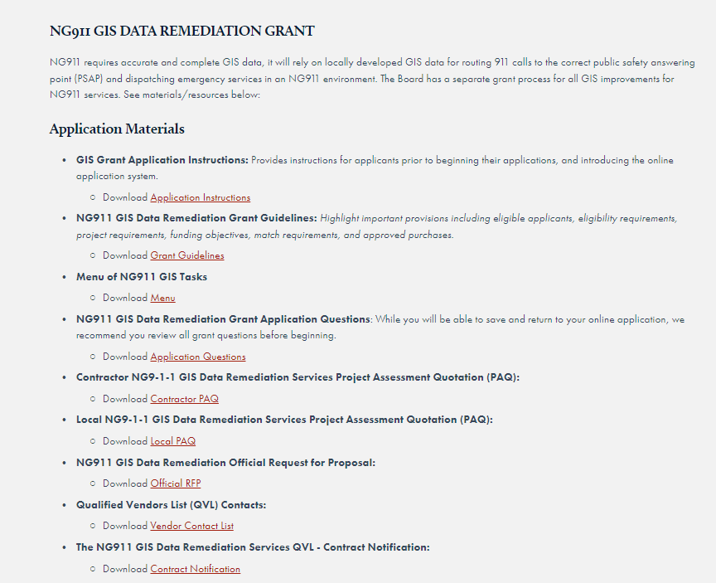
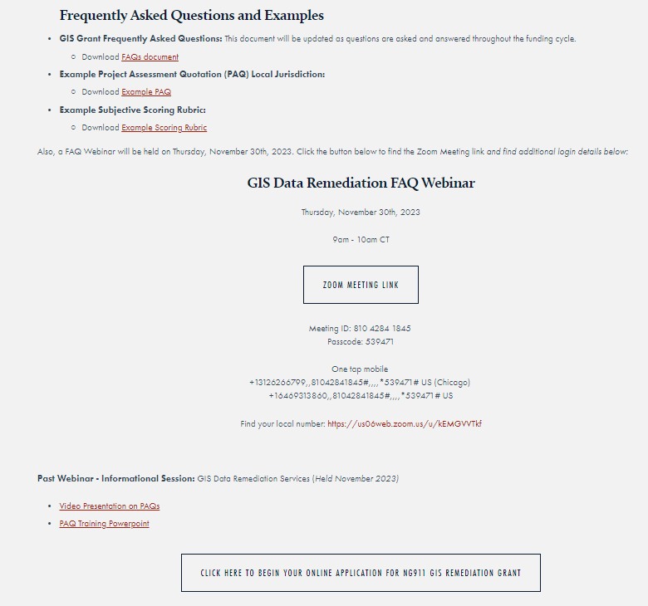
Grant Application Resources
https://www.missouri911.org/grants-and-funding-opportunities

Slide 14
NG911 GIS Data Portal-Coming Soon
Data Aggregation
Data Validation
Data Upload
NGCS Core Services
GIS Data

Slide 15
Maintenance
Submission
Validation
Feedback
Corrections
GIS Data Updates
NG911 GIS data on-going submission and validation
Similar to current MSAG process

Slide 16
Questions?
Shawn Penman, PhD, GISP, CFM
GIS Consultant
Phone: 505-220-5636
Email: shawn.penman@missouri911.org
Brian Maydwell, ENP
Executive Director Missouri 911 Service Board
Phone: 573-489-1088
Email: brian.maydwell@missouri911.org
MO911 Board Staff
Email: grants@missouri911.org

